Slide 1
Advanced WebDriver

Slide 2
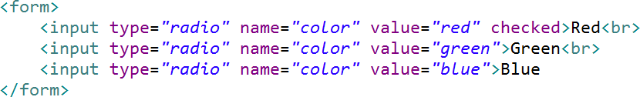
Radio Buttons

Slide 3
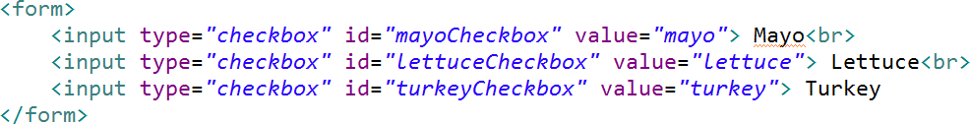
Checkboxes

Slide 4
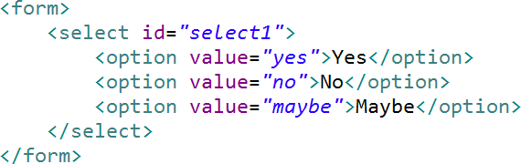
Select Items

Slide 5
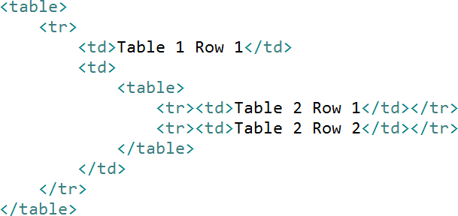
Tables

Slide 6

Waiting
<a href=“...”/>

Slide 7
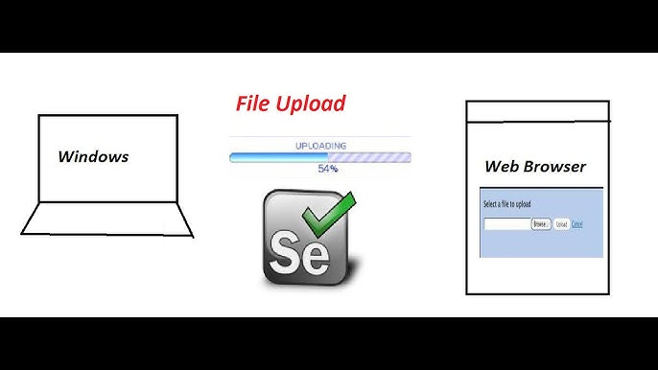
File Uploads with Auto IT

Slide 8

Radio Buttons
Checkboxes Select Items
Tables / Nested Tables
XPath
Explicit Waits VS Implicit Waits
IFrames
PopUps
Alerts and Key Presses
Switching windows
Take Screenshot
File Uploads with Auto IT
Summary

